Slide 1



Working with Azure Cosmos DB in Azure Functions
Will Velida – Software Engineer – ASB Bank

Slide 2

About Me
Software Engineer at ASB Bank, working in the Payments Platform.
From UK, lived in NZ for about 9 years.
.NET, Azure Cosmos DB, Azure Functions, Event Hubs, Storage, Log Analytics etc. etc.

Slide 3
Agenda
What is Azure Cosmos DB?
How Cosmos DB and Azure Functions work together.
Caveats and things to note.
Q&A.
Demo.

Slide 4



Azure Cosmos DB
A globally distributed, massively scalable, multi-model database service
SQL
MongoDB
Table API
Column-family
Document
Key-value
Graph
Guaranteed low latency at the 99th percentile
Elastic scale out
of storage & throughput
Five well-defined consistency models
Turnkey global distribution
Comprehensive SLAs

Slide 5
Why Azure Functions + Azure Cosmos DB?
Functions provide scalable units of work.
Don’t have to create a full app to work with Cosmos DB.
Build Event-driven apps that scale globally.

Slide 6
Cosmos DB Trigger and Binding Types
Action | Type
Run a function when an Azure Cosmos DB document is created or modified | Trigger
Read an Azure Cosmos DB document | Input Binding
Save changes to an Azure Cosmos DB document | Output Binding

Slide 7
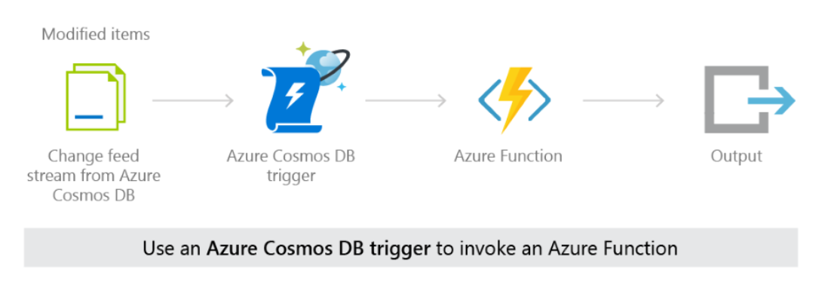
Event-driven Functions using Cosmos DB Change Feed. (Trigger)
Notes:
Change Feed works by listening to an Azure Conainer for any changes.
It then outputs those changes in the order that they arrived

Slide 8



Azure Cosmos DB Change Feed
Backup collection
Cold Storage
InsertProduct
Product Collection
ML Workloads

Slide 9
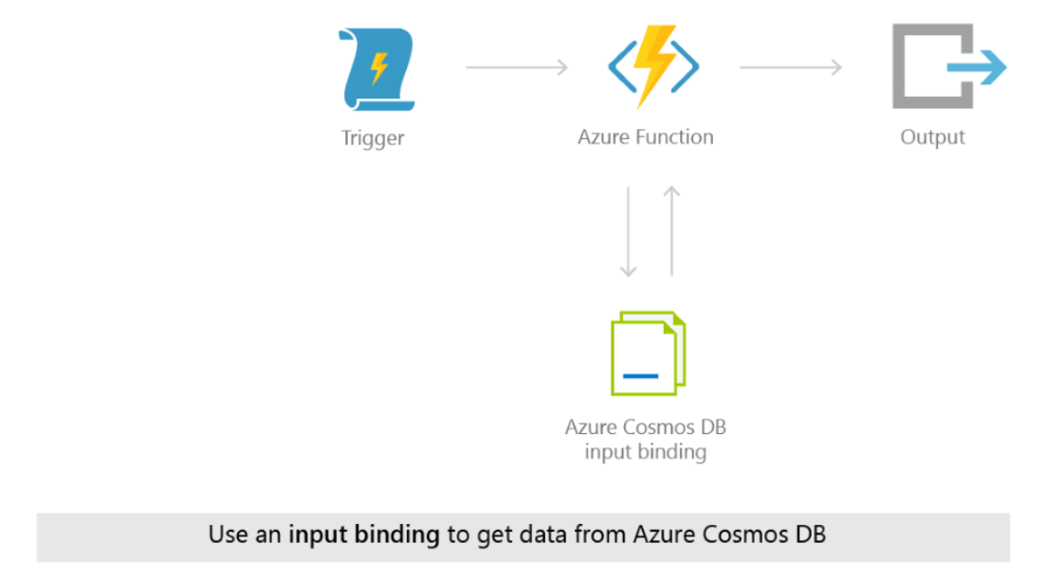
Read data from containers on Function Executions (Input Binding)

Slide 10
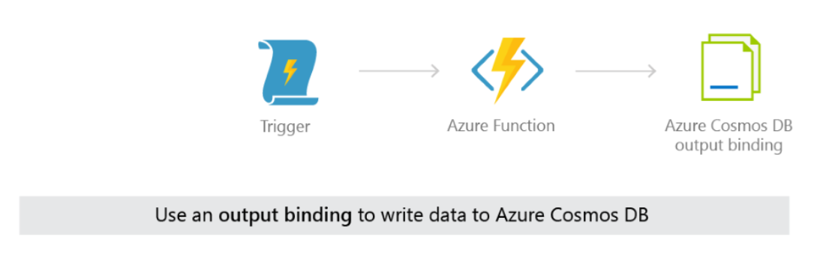
Write data to containers on Function execution (Output Binding)

Slide 11
Things to note
Bindings only support SQL API (Use static client for other APIs).
Each Binding instantiates it’s own DocumentClient instance.
Bindings currently use the v2 .NET SDK, not v3

Slide 12
Dependency Injection support
Azure Functions support Dependency Injection (Starting from 2.0).
Built on .NET Core DI Features.
Same service lifetimes as ASP.NET Dependency Injection
Transient
Scoped
Singletons
Notes:
From version 2, Azure Functions supports dependency injection
Transient: Transient services are created upon each request of the service.
Scoped: The scoped service lifetime matches a function execution lifetime. Scoped services are created once per execution. Later requests for that service during the execution reuse the existing service instance.
Singleton: The singleton service lifetime matches the host lifetime and is reused across function executions on that instance. Singleton lifetime services are recommended for connections and clients, for example SqlConnection or HttpClient instances.

Slide 13
Demo time!

Slide 14



Want to learn more?
Microsoft Learn.
Azure Functions Documentation.
Azure Cosmos DB Documentation.
Cosmos DB Deep Dive Labs.
Gotcosmos.com
25 Days of Serverless

Slide 15
Thanks for listening!
Twitter: @willvelida
LinkedIn: https://www.linkedin.com/in/willvelida/
Email: will.velida@asb.co.nz
GitHub: https://github.com/willvelida/global-integration-camp-2020

Slide 16
Any questions?

